Slide 1
MATH 241 E.A.P
October 15, 2019

Slide 2
Agenda
Sign IN
Questions pertaining to E.A.P
Questions Worksheets
Reviews on Derivatives
https://github.com/saitoshin45/math241/blob/master/derivative.pdf
Work on Worksheets
Sign Out

Slide 3

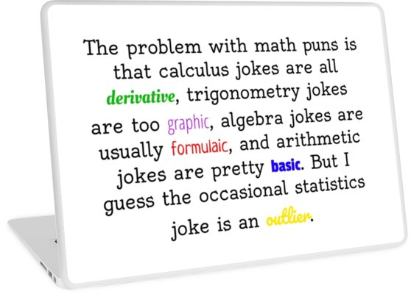

Slide 4

Additional Problems 1
Find the derivative using the definition of a derivatives
$g\left(x\right)= \frac{2x+1}{3x}$
F(x) = $3x^{2}−4x+1$

Slide 5

Additional Problems 2
Differentiate the following equations:
f(x) = $3x^{2}+48x^{1}+50x^{3}+\sin\left(x\right)+e^{70}$
$f\left(x\right)=\cos\left(x\right)+ \tan\left(x\right)−\sec\left(x\right)$

